Slide 1
Essential Design Principles for Tableau Assignment
File created on: 6/1/2023 2:12:00 PM

Slide 2
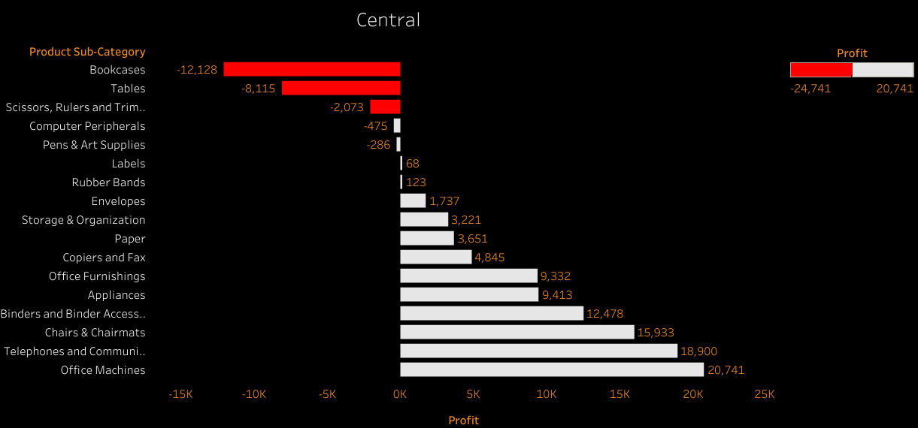

Slide 3
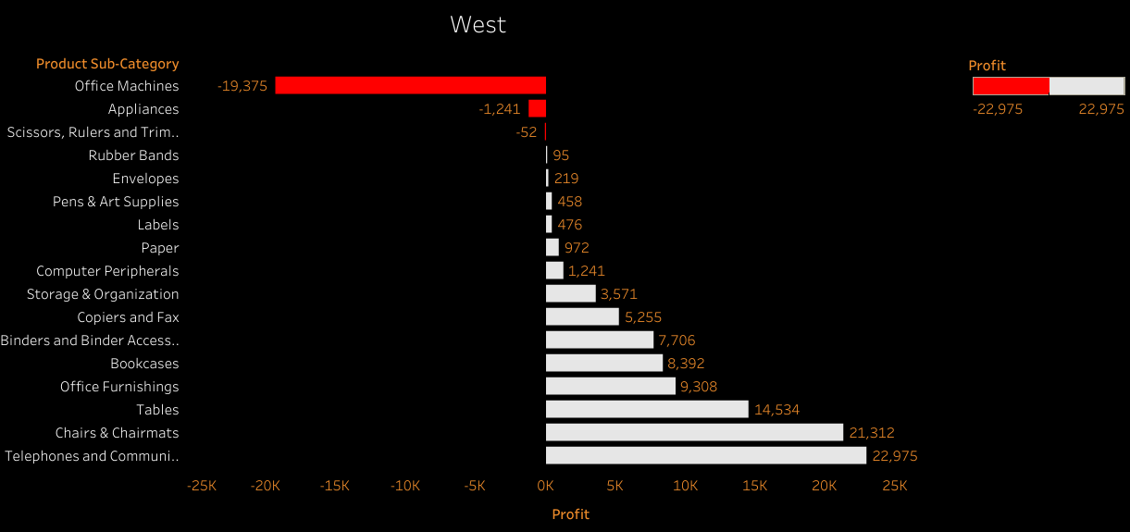

Slide 4
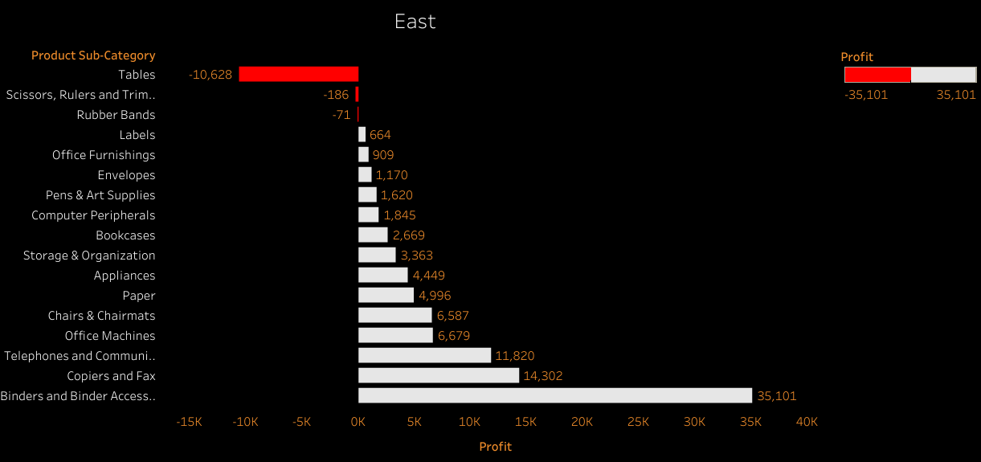

Slide 5
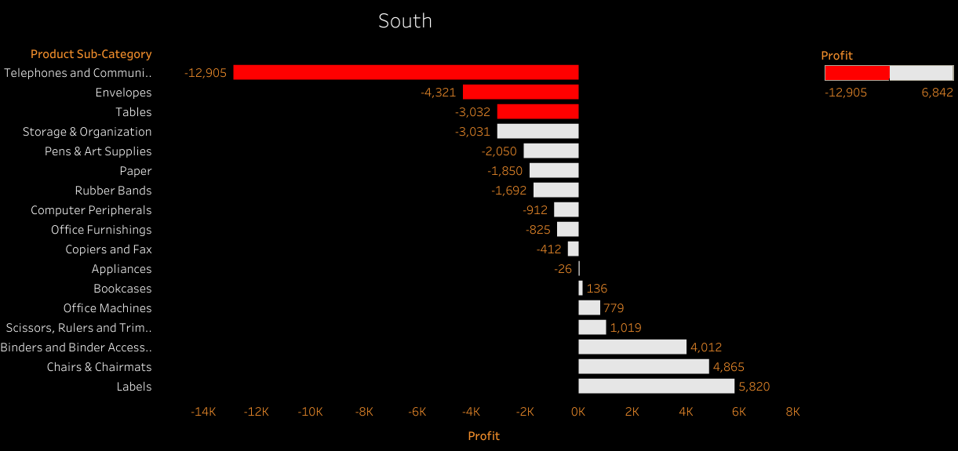

Slide 6
